Slide 1
WEEK 7
NLP in Pharma Commercial
Adverse events, field notes and social listening
Detecting adverse events in free text, explaining the model to a safety reviewer, and reusing the same tools on the rest of what the field writes down.
Andi Cupallari · Applied Data Science and AI in Pharma Commercial · Fall 2026 · Monday, October 26
Week 7 — NLP in Pharma Commercial: Adverse Events, Field Notes and Social Listening · Pharma DS&AI · Fall 2026
1 / 37
Notes:
Case: adverse-event detection in GLUCOREN field notes (fictional brand, Aspen Therapeutics; competitor CARDIVEX). All data synthetic. GenAI gets one slide; the full session comes later in the term.

Slide 2
AGENDA
Tonight
1
Text and the rules
Where the text comes from; what counts as an adverse event; when the clock starts
2
The toolbox
Bag of words, embeddings, transformers; precision and recall
3
Building the detector
Lexicon, then logistic regression; choosing the threshold
4
Explaining the model
Coefficients, word contributions, LIME, SHAP, leak checks
5
From flag to case
Four elements, seriousness, due date, PHI
6
Other uses of the same tools
Topics, social listening, MI routing, signal detection
7
Close
GenAI in one slide; governance; exercise
Week 7 — NLP in Pharma Commercial: Adverse Events, Field Notes and Social Listening · Pharma DS&AI · Fall 2026
2 / 37

Slide 3
01
Text and the rules
What gets written down, and what the regulator expects us to do with it
Week 7 — NLP in Pharma Commercial: Adverse Events, Field Notes and Social Listening · Pharma DS&AI · Fall 2026
3 / 37

Slide 4
1 · THE STREAMS
Three streams of text reach a brand team
Field call notes
Patient forum posts
Medical-information inquiries
▸ Typed by the rep after the visit
▸ Short, abbreviated, inconsistent
▸ 4,200 notes · 60 reps · 2,400 HCPs
▸ Company knowledge the moment they are saved
▸ A company-sponsored community and an independent forum
▸ First person, lay language
▸ 3,000 posts
▸ Duty to screen depends on who runs the site
▸ Phone, email, web form
▸ HCPs, pharmacists, patients, caregivers
▸ 1,200 inquiries
▸ Routed by intent; safety intake on all
~80%
34M
87%
94%
of EMR data is unstructured
clinical notes mined in one NLP chart-review program
fewer papers screened by hand with AI-assisted review
median share of adverse drug reactions never reported
Source: IQVIA, Harnessing the Power of AI in Medical Affairs (2025); Hazell & Shakir, Drug Safety 2006.
Week 7 — NLP in Pharma Commercial: Adverse Events, Field Notes and Social Listening · Pharma DS&AI · Fall 2026
4 / 37

Slide 5
1 · ONE NOTE
One call note, four jobs
Dr. reports BCBS is requiring prior authorization for GLUCOREN; two patients waiting over a week. Left PA form and hub phone number. Side note: a 58-year-old female patient reported dizziness within two weeks of starting; HCP managing conservatively. HCP also asked whether GLUCOREN could be used in a type 1 patient — referred to Medical Information. Mrs. Kowalski to call the office back.
Access insight
PA barrier at BCBS → payer team
Adverse event
patient + event + drug + reporter → safety intake; clock running
Off-label request
unsolicited → Medical Information; rep does not engage
PHI
a patient name in free text → scrub before storage
Tonight builds the second row. The others use the same methods with different labels.
Source: Synthetic note, composed for illustration.
Week 7 — NLP in Pharma Commercial: Adverse Events, Field Notes and Social Listening · Pharma DS&AI · Fall 2026
5 / 37

Slide 6
1 · DEFINITIONS
What the regulation says
Term | 21 CFR 314.80 | For the model
Adverse drug experience | Any adverse event associated with the use of a drug in humans, whether or not considered drug related | Association opens a case; causality is not the model's job
Serious | Death; life-threatening; hospitalization; persistent disability; congenital anomaly; other medically important event | A second label
Unexpected | Not listed in the current labeling | Lookup against the label
15-day Alert report | Serious and unexpected: report within 15 calendar days of initial receipt | The deadline the queue computes
Periodic report | Everything else | Still a case
FDA “will consider an applicant responsible for information known to its employees, affiliates, and contractors.” A saved call note is company knowledge.
— FDA draft guidance, Postmarketing Safety Reporting (2001), §X
Source: 21 CFR §314.80; ICH E2D (2003).
Week 7 — NLP in Pharma Commercial: Adverse Events, Field Notes and Social Listening · Pharma DS&AI · Fall 2026
6 / 37

Slide 7
1 · FOUR ELEMENTS
A case needs four things
Identifiable patient
“a 58-year-old female”, “one of his patients”
Identifiable reporter
the HCP, a caller, a forum member
Suspect drug
GLUCOREN, implicit in a brand call
Adverse experience
the event, in any words
Not a case
So the pipeline answers, in order
▸ “No reports of nausea” (negation)
▸ “Asked about the nausea rate in the label” (no patient)
▸ “Worried about side effects before starting” (hypothetical)
▸ A competitor's patient (not our product)
▸ AE mentioned? classifier
▸ Four elements? rules
▸ Serious? Unexpected? lexicon and label lookup
▸ Due date awareness date + 15 days if serious and unexpected
Source: FDA draft guidance (2001), §IV.B; ICH E2D.
Week 7 — NLP in Pharma Commercial: Adverse Events, Field Notes and Social Listening · Pharma DS&AI · Fall 2026
7 / 37

Slide 8
1 · WHICH MEDIA
Which text you are obliged to look at
FDA (2001 draft guidance, §VI.G)
EMA GVP Module VI (Rev 2, VI.B.1.1.4)
▸ “Applicants should review any Internet sites sponsored by them for adverse experience information.” Sites they do not sponsor: no duty to review; a duty to act on what they become aware of.
▸ MAHs “should regularly screen internet or digital media under their management or responsibility.” Media outside their control: act on awareness.
Stream | Who runs it | Duty
Aspen “Living with T2D” community | the company | screen regularly
T2D Circle forum | independent | act on what you see
Field notes, MI inquiries | the company | company knowledge
Running social listening on a site you do not control is a decision to acquire knowledge you must then act on. Route cases to Safety before anything goes to a dashboard.
Source: FDA (2001) §VI.G; EMA GVP Module VI Rev 2 (2017).
Week 7 — NLP in Pharma Commercial: Adverse Events, Field Notes and Social Listening · Pharma DS&AI · Fall 2026
8 / 37

Slide 9
02
The toolbox
Text into numbers, and how to judge the result
Week 7 — NLP in Pharma Commercial: Adverse Events, Field Notes and Social Listening · Pharma DS&AI · Fall 2026
9 / 37

Slide 10
2 · TEXT TO NUMBERS
Three ways to represent a sentence
 | Bag of words / TF-IDF | Static embeddings | Contextual transformers
Idea | count terms; weight rare ones up | one vector per word, learned from co-occurrence | one vector per token in context, pretrained on large corpora
Knows that | “nausea” ≠ “vomiting” | “nausea” ≈ “vomiting” | “no nausea” ≠ “nausea”
Needs | labels | a corpus or a download | a download, a GPU to fine-tune, labels
Explained by | coefficients | nearest neighbours | Integrated Gradients; attention with care
Tonight | the detector | LSA stand-in for search | optional cell
Model | Pretrained on | Use for
BERT (Devlin 2019) | Wikipedia, books | general English: rep notes, patient posts
BioBERT (Lee 2020) | PubMed, PMC | literature, biomedical NER
ClinicalBERT (Alsentzer 2019) | MIMIC clinical notes | chart review
Sentence-BERT (Reimers 2019) | sentence pairs | search, clustering, BERTopic
Source: Pang, Lee & Vaithyanathan 2002; Deerwester et al. 1990; Devlin et al. 2019; Lee et al. 2020; Alsentzer et al. 2019; Reimers & Gurevych 2019.
Week 7 — NLP in Pharma Commercial: Adverse Events, Field Notes and Social Listening · Pharma DS&AI · Fall 2026
10 / 37

Slide 11
2 · THE LADDER
Four rungs
Rules / lexicon
minutes to build · no labels · transparent
Classical ML
TF-IDF + logistic regression · labels · exact explanations
Fine-tuned transformer
BioBERT head · labels + GPU · best on hard text
LLM, zero-shot
a prompt · no labels · cost per call · still measured
Climb when
Stay when
▸ error analysis shows negation, paraphrase or abbreviations the rung below cannot handle;
▸ you have labels;
▸ the gain holds on a held-out set.
▸ the text is short and formulaic (CRM notes usually are);
▸ the reviewer needs to see why;
▸ the model has to be documented in a validated process.
Tonight stops at rung two and shows how to read rungs three and four when a vendor brings them.
Source: Karimi et al., ACM Computing Surveys 2015; Rudin, Nature Machine Intelligence 2019.
Week 7 — NLP in Pharma Commercial: Adverse Events, Field Notes and Social Listening · Pharma DS&AI · Fall 2026
11 / 37

Slide 12
2 · PRECISION AND RECALL
Judge a detector by its operating point
Precision
Recall
The curve
▸ Of the notes we flag, how many are real. Low precision wastes reviewer time.
▸ Of the real AEs, how many we catch. Low recall means unreported cases. In safety this comes first.
▸ Each threshold is a (recall, precision) pair. AUC and AP compare models; the chosen point is the decision.
Write down: target recall, resulting precision, flags per week, reviewer hours, cases missed per year. F1 hides all of that.
Week 7 — NLP in Pharma Commercial: Adverse Events, Field Notes and Social Listening · Pharma DS&AI · Fall 2026
12 / 37

Slide 13
03
Building the detector
A lexicon to find the failure modes, then a model that reads context
Week 7 — NLP in Pharma Commercial: Adverse Events, Field Notes and Social Listening · Pharma DS&AI · Fall 2026
13 / 37

Slide 14
3 · LEXICON
Lexicon of 77 lay terms: recall 79%, precision 42%
Method
What a lexicon cannot tell
▸ Flag a note if any lay term appears (nausea, threw up, sugar lows, hospitalized…). Score against the PV reviewer's labels on the reviewed notes.
▸ Who: a patient, or the label?
▸ Whether: present, denied, hypothetical?
▸ Spelling: typos, abbreviations, paraphrase
False positives: word present, no event
False negatives: event present, word missing
▸ “no reports of yeast infection”
▸ “asked how common hypoglycemia was in the trials”
▸ “patient education materials on hypoglycemia awareness”
▸ “a 38yo male on metformin + SU w/ sugar lows, fyi”
▸ “burning when urinating after starting”
▸ “N/V”, “GI issues”, “nuasea”
The lexicon stays as the seriousness and expectedness lookup. It stops being the detector.
Source: Karimi et al. 2015. Numbers: notebook §3, reviewed notes.
Week 7 — NLP in Pharma Commercial: Adverse Events, Field Notes and Social Listening · Pharma DS&AI · Fall 2026
14 / 37

Slide 15
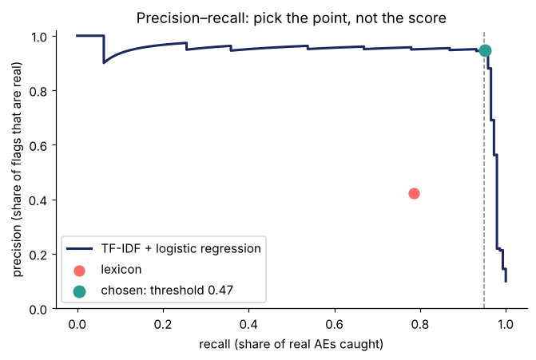
3 · LOGISTIC REGRESSION
TF-IDF + logistic regression: AUC 0.99, average precision 0.94
Recipe
▸ 1–2-grams, TF-IDF, L2 logistic regression, class weights. Negation scope: the three words after “no”, “denied” or “without” get a NOT_ prefix, so “no nausea” is a different feature from “nausea”.
 | Precision | Recall | Flagged
Lexicon | 42% | 79% | 270
LR at 0.50 | 94% | 93% | —
LR at 0.47 (recall ≥ 95%) | 95% | 95% | 146
Reviewed notes: 1,458, 5-fold CV. On the 2,742 unreviewed notes (instructor truth): recall 96%, precision 94%.
Source: Pang, Lee & Vaithyanathan 2002. Numbers: notebook §4.
Week 7 — NLP in Pharma Commercial: Adverse Events, Field Notes and Social Listening · Pharma DS&AI · Fall 2026
15 / 37

Slide 16
3 · THRESHOLD
The threshold is a business decision
Threshold | Recall | Precision | Flags / week | Reviewer hours / week | AEs missed / year
0.20 | 97% | 62% | 13 | 1.3 | 12
0.30 | 97% | 80% | 10 | 1.0 | 14
0.47 | 95% | 95% | 8 | 0.8 | 20
0.50 | 93% | 94% | 8 | 0.8 | 29
0.70 | 79% | 95% | 7 | 0.7 | 89
▸ Assumptions: 6 minutes per note for a trained reviewer; about 84 notes a week; the reviewed sample represents the stream.
▸ Choice: at 95%+ recall the reviewer spends under an hour a week. Trading recall for that hour is not worth it.
▸ The cost table goes into the model documentation; it is what an inspector asks for.
Source: Numbers: notebook §4.
Week 7 — NLP in Pharma Commercial: Adverse Events, Field Notes and Social Listening · Pharma DS&AI · Fall 2026
16 / 37

Slide 17
3 · PROBES
Five sentences every retrain has to pass
Probe | Tests | p(AE)
Patient developed nausea after starting GLUCOREN and stopped the drug. | plain positive | 0.94
Patient had no nausea after starting GLUCOREN; tolerating well. | negation | 0.34
HCP asked about the nausea rate in the label; no specific patient discussed. | general statement, no patient | 0.07
One of his pts had N/V within 2 wks of starting, dose reduced. | abbreviations | 0.99
A 61 y/o F was hospitalized with pancreatitis three weeks after starting GLUCOREN. | serious, unexpected event | 0.87
Keep the list in version control and run it on every retrain.
Source: Ribeiro et al., ACL 2020 (CheckList). Numbers: notebook §5e.
Week 7 — NLP in Pharma Commercial: Adverse Events, Field Notes and Social Listening · Pharma DS&AI · Fall 2026
17 / 37

Slide 18
04
Explaining the model
A safety reviewer acts on the span, not the score
Week 7 — NLP in Pharma Commercial: Adverse Events, Field Notes and Social Listening · Pharma DS&AI · Fall 2026
18 / 37

Slide 19
4 · WHY
Why explanations are required here
“If you cannot explain how your AI came to a decision, it does not belong in a compliance system.”
“The MAH will hold the ultimate responsibility for the AI that is used in their system and will need to document all AI usage information within the PV System Master File.”
— IQVIA, Expert Predictions for 2026 (safety and pharmacovigilance)
— IQVIA, Demanding More from AI Governance in Drug Safety
Question | Scope | Method | Reference
What does the model think an AE looks like? | global | coefficients | Molnar 2022
Why was this note flagged? | local, exact | coefficient × TF-IDF weight per word | —
Same, for a black box | local, model-agnostic | LIME | Ribeiro et al. 2016
Same, with consistent credit | local and global | SHAP | Lundberg & Lee 2017
Which tokens, for a transformer? | local | Integrated Gradients | Sundararajan et al. 2017; Jain & Wallace 2019
Source: IQVIA 2025 (both papers); Rudin 2019 on preferring interpretable models for high-stakes decisions.
Week 7 — NLP in Pharma Commercial: Adverse Events, Field Notes and Social Listening · Pharma DS&AI · Fall 2026
19 / 37

Slide 20
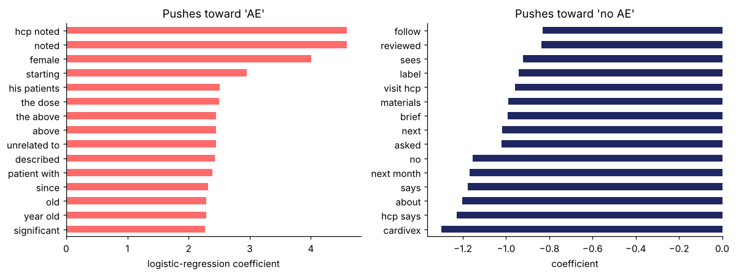
4 · GLOBAL
What the model learned
Reading it
▸ Toward AE: event words and case words (“hcp noted”, “noted”, “female”, “starting”).
▸ Away: negation and generality (“cardivex”, “hcp says”, “about”, “says”).
▸ A payer, a region or a rep's habit in these panels is a shortcut to remove.
Source: Notebook §5a; pure function words hidden from the chart, kept in the model.
Week 7 — NLP in Pharma Commercial: Adverse Events, Field Notes and Social Listening · Pharma DS&AI · Fall 2026
20 / 37

Slide 21
4 · LOCAL
Why this note was flagged
N01992 · p(AE) = 0.97 · flagged = 1 · lexicon = 1
Dr. reports Express Scripts is requiring prior authorization for GLUCOREN; two pts waiting over a week. Left PA form and hub phone number. Also metnioned one of her pts dropped off GLUCOREN due to headache w/in 48 hours of starting.
N03087 · p(AE) = 0.11 · flagged = 0 · lexicon = 1
HCP asked whether hypo is dose-related and whether titration helps. Shared the dosing section of the PI. Office staff friendly as always.
Coral pushes toward AE, navy away. Contribution = coefficient × TF-IDF weight, so the highlights are exact.
This is what goes in the reviewer's queue: the note with the span, not a probability.
Source: Notebook §5b.
Week 7 — NLP in Pharma Commercial: Adverse Events, Field Notes and Social Listening · Pharma DS&AI · Fall 2026
21 / 37

Slide 22
4 · LIME
LIME in four steps
1 · Perturb
switch words off at random; 400 neighbours
2 · Query
ask the model for p(AE) on each
3 · Weight
closer neighbours count more
4 · Fit
a weighted linear model; read its weights
“A 49 y/o m — constipated. Dose held, HCP to reassess.” → p(AE) = 0.95
Cautions
▸ Local and unstable: change the seed and compare.
▸ Perturbed sentences are ones nobody writes; the model is being asked about inputs off its data.
▸ Works on any model, which is the point.
word | weight
held, | +0.132
reassess. | +0.097
Dose | +0.095
to | +0.063
HCP | +0.046
49 | -0.056
y/o | -0.013
Source: Ribeiro, Singh & Guestrin, KDD 2016. Example: notebook §5c, fifteen lines of code.
Week 7 — NLP in Pharma Commercial: Adverse Events, Field Notes and Social Listening · Pharma DS&AI · Fall 2026
22 / 37

Slide 23
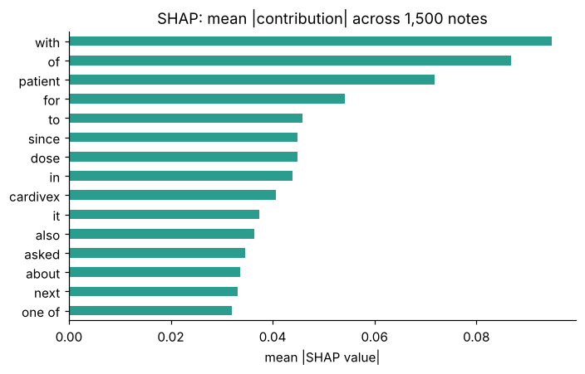
4 · SHAP AND THE LEAK CHECK
SHAP, and a sanity check that found a shortcut
SHAP
▸ Shapley values: each feature's share of the prediction, with consistency guarantees. Mean |SHAP| ranks by how often a term matters as well as how strongly, so the ranking differs from the coefficients.
Payer names in the vocabulary
▸ |coef| > 0.5: “optumrx moved” (+2.0), “cigna is” (+1.8), “reports cigna” (+1.8), “optumrx” (+1.1).
▸ A shortcut from the training sample. Mask payer names → “payer”, refit: accuracy unchanged, vocabulary clean.
Explanations are for finding problems. Mask entities, refit, re-check.
Source: Lundberg & Lee, NeurIPS 2017. Notebook §5d–5e. For transformers: Jain & Wallace 2019 (attention is not explanation); Sundararajan et al. 2017 (Integrated Gradients).
Week 7 — NLP in Pharma Commercial: Adverse Events, Field Notes and Social Listening · Pharma DS&AI · Fall 2026
23 / 37

Slide 24
05
From flag to case
Rules after the model
Week 7 — NLP in Pharma Commercial: Adverse Events, Field Notes and Social Listening · Pharma DS&AI · Fall 2026
24 / 37

Slide 25
5 · THE RULES
Rules on top of the classifier
p(AE) ≥ threshold
458 notes
Identifiable patient?
418 valid cases
Serious terms?
51
Not in label?
50 15-day candidates
Due date
awareness + 15 days
Rule | How | Against instructor truth
Identifiable patient | regex: age/sex, “one of his patients”, a name, an MRN | precision 1.00, recall 0.93
Seriousness | lexicon: hospitalized, ER, ICU, died, pancreatitis… | —
Unexpected | lexicon column in_label = N | —
15-day candidate | valid and serious and unexpected | precision 1.00, recall 0.93 (50 of 51)
PHI in note | DOB, MRN, Mr./Mrs. + name, “patient First Last” | precision 1.00, recall 1.00
Source: Notebook §6. The missed 15-day cases were missed by the classifier upstream.
Week 7 — NLP in Pharma Commercial: Adverse Events, Field Notes and Social Listening · Pharma DS&AI · Fall 2026
25 / 37

Slide 26
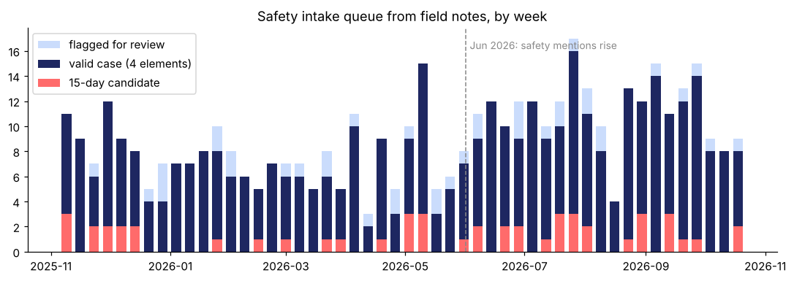
5 · THE QUEUE
The intake queue, by week
Reading it
▸ About 9 flags a week, 0.9 reviewer-hours.
▸ 50 15-day candidates over the year.
▸ Safety mentions rise from June 2026.
▸ Reps are trained to report within one business day; the queue catches what the SOP missed, with the clock already running.
Source: Notebook §6.
Week 7 — NLP in Pharma Commercial: Adverse Events, Field Notes and Social Listening · Pharma DS&AI · Fall 2026
26 / 37

Slide 27
5 · SIDE EFFECTS
Two rules the text brings with it
PHI in free text
Off-label mentions
▸ Found: 28 flagged notes with a name, DOB or MRN.
▸ Rule: HIPAA Safe Harbor lists 18 identifiers to remove before text is de-identified (45 CFR 164.514(b)).
▸ Practice: scrub at ingestion, and before any text leaves the firewall.
▸ What: unsolicited HCP questions about unapproved uses.
▸ Rule: document, route to Medical Information; the rep does not engage.
▸ Model: the same classifier family detects them (Field Guide exercise).
Source: 45 CFR §164.514(b).
Week 7 — NLP in Pharma Commercial: Adverse Events, Field Notes and Social Listening · Pharma DS&AI · Fall 2026
27 / 37

Slide 28
06
Other uses of the same tools
Topics, social listening, routing, signals
Week 7 — NLP in Pharma Commercial: Adverse Events, Field Notes and Social Listening · Pharma DS&AI · Fall 2026
28 / 37

Slide 29
6 · THE MAP
NLP use cases in pharma commercial
Use case | Text | Method | Output | Owner
AE detection | notes, posts, MI | classifier + rules | cases with due dates | Safety
What the field hears | call notes | topic model, rolled up | theme share by month, segment | Brand, insights
HCP sentiment | notes, surveys, ad boards | lexicon or classifier | negative share, drivers | Brand
Social listening | forums, social | classifier with own labels | tolerability themes, patient language | Insights, Safety
MI routing | inquiries | intent classifier | queue assignment | Medical Information
Semantic search | approved content, notes | embeddings | retrieval for reps, MSLs, MI | Medical, commercial ops
Literature and chart review | papers, EMR notes | screening models, NER | evidence tables, RWE variables | Medical Affairs
KOL profiling | publications, abstracts | NER, topics, networks | expert maps | Medical Affairs
Signal detection | the safety database | disproportionality | signals for committee review | PV
Source: IQVIA, AI in Medical Affairs (2025); IQVIA, Harnessing AI to Innovate Medical Information (2025).
Week 7 — NLP in Pharma Commercial: Adverse Events, Field Notes and Social Listening · Pharma DS&AI · Fall 2026
29 / 37

Slide 30
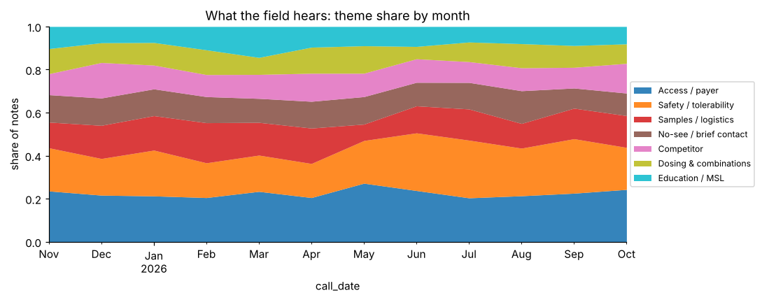
6 · WHAT THE FIELD HEARS
Theme share by month
Reading it
▸ Safety share 18% before June, 25% after.
▸ Access is the largest theme (945 notes), 37% negative.
▸ NMF finds sub-themes (PA, copay, Medicare gap); we roll them up and assign safety with the detector.
▸ Competitor mentions track the CARDIVEX label update (notebook §7).
Source: Lee & Seung 1999 (NMF); Blei, Ng & Jordan 2003 (LDA); Grootendorst 2022 (BERTopic); Hutto & Gilbert 2014 (sentiment lexicon). Notebook §7.
Week 7 — NLP in Pharma Commercial: Adverse Events, Field Notes and Social Listening · Pharma DS&AI · Fall 2026
30 / 37

Slide 31
6 · SOCIAL LISTENING
The same detector on patient posts
Model | Precision | Recall
Trained on rep notes, scored on posts | 64% | 91%
Lexicon on posts | 64% | 85%
Trained on post labels (5-fold CV) | 94% | 99%
From the literature
▸ Social-media AEs skew to mild, symptom-level events and under-represent serious ones (Golder et al. 2015).
▸ Twitter event rankings correlated with FAERS; counts did not (Freifeld et al. 2014).
▸ Lay language is the main difficulty; embeddings help (Nikfarjam et al. 2015).
Source | Posts | Flagged | Serious terms | Duty
Aspen community (sponsored) | 1,201 | 311 | 43 | screen regularly
T2D Circle forum | 1,799 | 452 | 90 | act on awareness
Label the new stream before trusting a model trained on another one.
Source: Golder, Norman & Loke 2015; Freifeld et al. 2014; Nikfarjam et al. 2015; Sarker et al. 2015.
Week 7 — NLP in Pharma Commercial: Adverse Events, Field Notes and Social Listening · Pharma DS&AI · Fall 2026
31 / 37

Slide 32
6 · MI ROUTING
Medical-information routing
Inquiry
phone, email, web form
Intent classifier
8 intents, accuracy 92%
Route
MI specialist, Safety, Quality, Access
Safety detector on all
111 of 333 AE mentions were in non-AE intents
“…the automatic transfer of adverse events (AEs) and product complaints (PQCs) to their requisite systems, which helps maintain compliance amid spikes.”
“In medical information, most data is spontaneous and unstructured. That implies a huge responsibility for our confidentiality and how we handle that data.”
— IQVIA, Harnessing AI to Innovate Medical Information (2025)
— IQVIA, Expert Predictions for 2026
A dosing call that mentions nausea is a dosing call and a case.
Source: Notebook §9.
Week 7 — NLP in Pharma Commercial: Adverse Events, Field Notes and Social Listening · Pharma DS&AI · Fall 2026
32 / 37

Slide 33
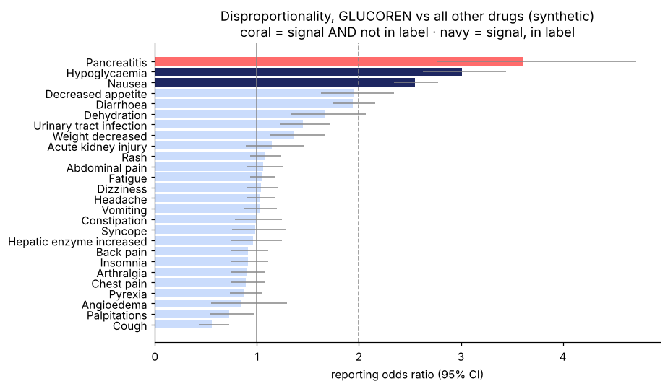
6 · SIGNALS
From cases to a signal
PRR and ROR
▸ PRR = (a/(a+b)) ÷ (c/(c+d)); ROR = ad/bc with a 95% CI. Evans's screen: PRR ≥ 2, χ² ≥ 4, n ≥ 3. Bayesian shrinkage (BCPNN) for sparse cells.
Synthetic FAERS-style counts
▸ Signals: Pancreatitis, Hypoglycaemia, Nausea.
▸ Pancreatitis, PRR 3.6, not in the label: signal-review committee.
▸ No exposure denominator and heavy under-reporting: a hypothesis, not a rate.
Source: Evans, Waller & Davis 2001; Bate et al. 1998; Harpaz et al. 2012. Notebook §10; search with LSA/embeddings in §11.
Week 7 — NLP in Pharma Commercial: Adverse Events, Field Notes and Social Listening · Pharma DS&AI · Fall 2026
33 / 37

Slide 34
07
Close
GenAI in one slide, governance, exercise
Week 7 — NLP in Pharma Commercial: Adverse Events, Field Notes and Social Listening · Pharma DS&AI · Fall 2026
34 / 37

Slide 35
7 · GENAI
Large language models change the cost of this pipeline, not its logic
What changes
What does not
▸ Zero-shot extraction: a prompt returns the four elements from a note with no training set.
▸ Normalization and narrative: lay term to coding dictionary; case narratives; weekly summaries of field notes.
▸ Retrieval plus generation: answers grounded in approved content.
▸ The target: four elements, seriousness, the 15-day clock.
▸ The human: every case is reviewed.
▸ The data rules: PHI scrubbed before text leaves the firewall.
▸ The evidence: precision, recall and workload on your own labelled data.
>70%
The GenAI session covers prompting and evaluation, hallucination, RAG over MLR-approved content, cost, and the FDA's 2025 draft guidance on AI credibility. Tonight's detector is the baseline.
of GenAI experiments never reach production
Source: IQVIA, Where to Deploy Generative AI Solutions in Life Sciences (2025); FDA draft guidance, January 2025.
Week 7 — NLP in Pharma Commercial: Adverse Events, Field Notes and Social Listening · Pharma DS&AI · Fall 2026
35 / 37

Slide 36
7 · GOVERNANCE
What the PV lead will ask for
Item | Write down
Context of use | which stream, which decision, who acts, what happens on error
Data | source, period, reviewer labels and their noise, PHI handling
Performance | AUC and AP for comparison; the operating point with recall, precision, workload; held-out and behavioural tests
Explanations | global review, per-flag spans, leak checks
Human oversight | who reviews every flag; escalation; the SOP it sits beside
Monitoring | flag-rate drift, probes on every retrain, domain shift on new streams
Record | the PV System Master File
Source: FDA / Health Canada / MHRA, Good Machine Learning Practice (2021); FDA draft guidance (Jan 2025); IQVIA (Raizada) 2025.
Week 7 — NLP in Pharma Commercial: Adverse Events, Field Notes and Social Listening · Pharma DS&AI · Fall 2026
36 / 37

Slide 37
7 · EXERCISE
In-class exercise, 25 minutes, pairs
A
A · Eight notes by hand (10 min)
B
B · Read an explanation (8 min)
C
C · Set the threshold (7 min)
▸ AE? four elements? serious? unexpected? due date? Write the phrase that decided it.
▸ Two word-contribution outputs. Trust the flag? Send the model back? Which probe to add?
▸ Reviewer budget of 2 hours a week: pick the threshold, state the misses, justify it to Safety. Then triple the volume.
When | What
Mon Nov 2 | Academic holiday. Homework 2 due 11:59 PM ET
Mon Nov 9 | Midterm, closed book, Weeks 1–7. Study guide posted a week ahead
Mon Nov 16 | Guest speaker: agentic AI in pharma commercial. Two questions in advance
Week 7 — NLP in Pharma Commercial: Adverse Events, Field Notes and Social Listening · Pharma DS&AI · Fall 2026
37 / 37
Notes:
Confirm the Nov 2 deadline given the holiday. Study guide to post by Nov 2.

